Slide 1
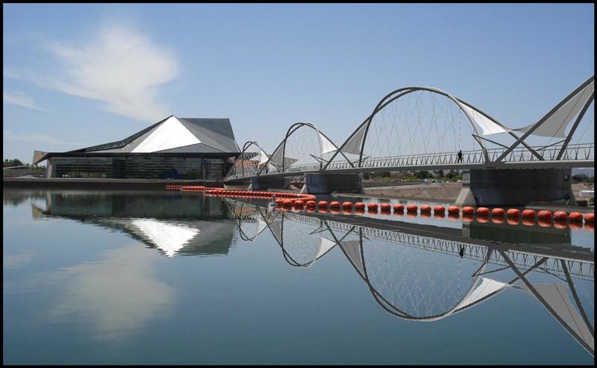

Biogeochemical And Hydrologic Processes of Tempe Town Lake
Marissa Raleigh

Slide 2
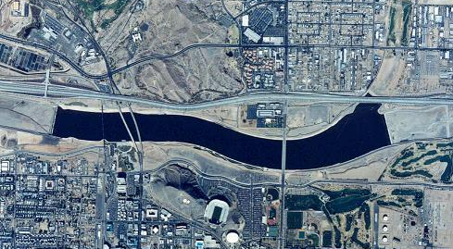
Tempe Town Lake Background
Tempe Town Lake was designed for both flood control and recreation.
It is held in on either side of the lake by inflatable dams that lower in the event of a flood.
In July 2010, one of the inflatable dams burst and the lake was drained of water.
It was refilled in October 2010 with water from Tempe’s New Conservation Storage at Roosevelt Lake, which is essentially Salt river water.
Water in the lake is mainly lost through evaporation (not seepage), and that water is generally replaced with reclaimed water.
Because of the way that Tempe Town Lake was constructed, there is very little water loss to seepage. The main source of water loss for the lake is through evaporation. Normally, to make up for the loss of water through evaporation, the City of Tempe usually fills the lake with reclaimed or Salt River water. However, due to the recent dam break in July 2010, the lake was filled with water from Tempe’s New Conservation Storage (NCS) at Roosevelt Lake, which is a part of the Salt River.
Tempe Town Lake is approximately 2 miles long (shown at left)

Slide 3
Methods
The sampling of Tempe Town lake is a project that has been an ongoing project for the Hartnett lab from 2005 to the present.
I collected samples from Sept. 2011 through April 2012 and compared my data with previous results from the Hartnett lab.
Temperature, pH, conductivity, and dissolved oxygen are measured in the field with handheld meters.
Alkalinity is titrated using H₂SO₄ with phenolthalein and bromcresol green/methyl red indicators.
Dissolved organic carbon (DOC) and total nitrogen (TN) concentrations are found through high temperature catalytic oxidation.

Slide 4
Data
Most of the measurements that are taken vary with the time of year, the rainfall, the place where the water in the lake came from, or some combination of the three.
The pH of the lake is the only factor that does not really vary in accordance with these factors and is usually around 8 to 9.
The main data that is collected from Tempe Town Lake is the data that measures the amount of dissolved organic carbon(DOC) in the lake.

Slide 5
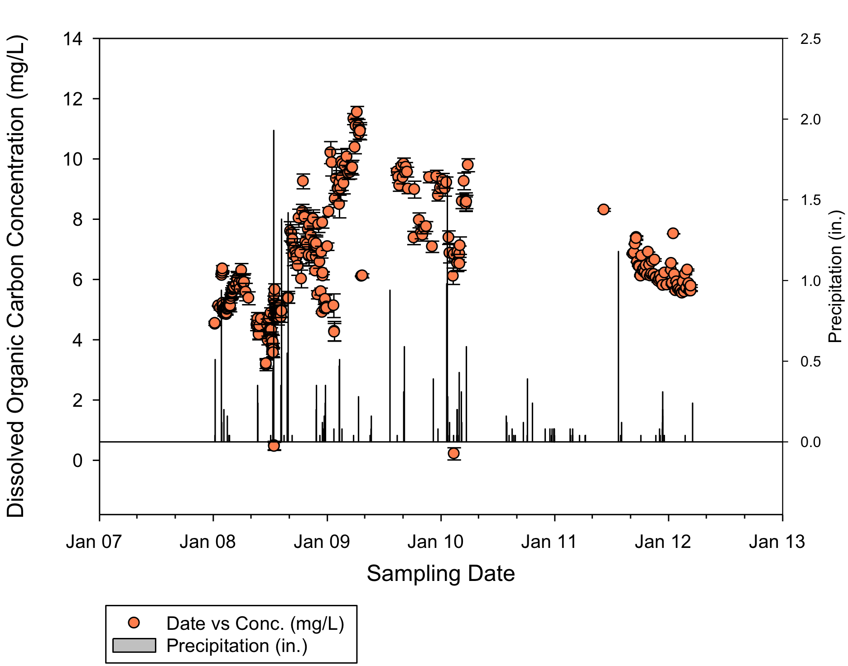
Data
This graph depicts the concentration of DOC in Tempe Town Lake going back through January 2008 plotted with the error and the precipitation.
The DOC concentration generally varies such that it is higher in the hotter summer months, and it is lower in the winter. It is also affected by rainfall such that concentration goes down with increased rainfall.

Slide 6
Summary
Dissolved Organic Carbon is an important component in the carbon cycle, and it serves as the primary food source for many of the microorganisms that survive in Tempe Town Lake. By measuring the DOC, as well as all of the other measurements that are taken, we can make conclusions about the carbon cycling in this man-made lake. We can also conclude that from a biogeochemistry standpoint, Tempe Town Lake behaves like a natural lake.

Slide 7
Questions or Comments?
Name: Marissa Raleigh
Email: mraleigh@asu.edu
OR
Name: Hilairy Hartnett
Email: h.hartnett@asu.edu

